Slide 1

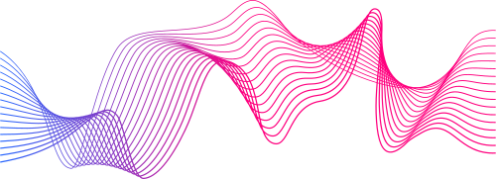
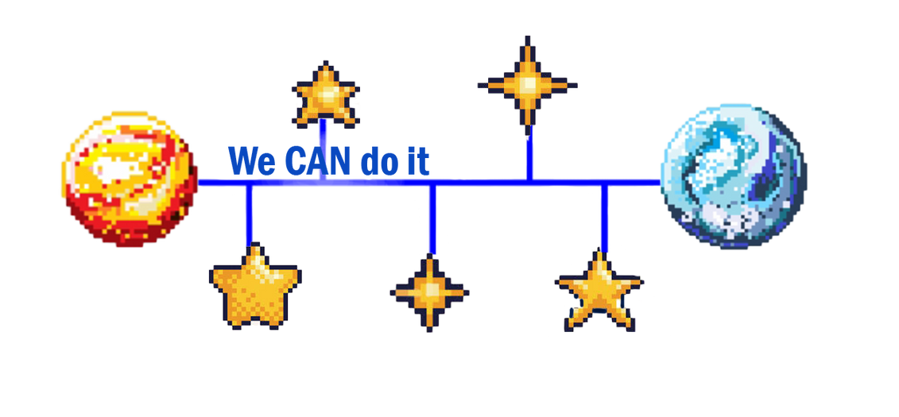
AstroCAN
Immerse in the Sounds of Space
PRESENTED AT
NASA International Space Apps Challenge
2023
PRESENTED BY
We CAN do it

Slide 2
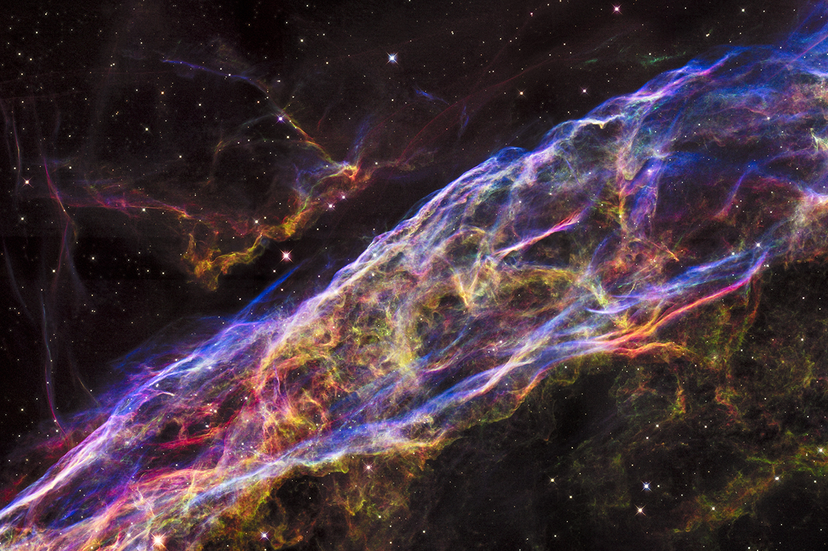
The challenge
Sonify 2D images and find a solution for real life problems using them
Find the most sustainable way of using the acquired information

Slide 3
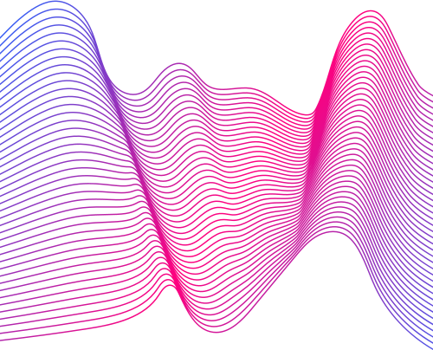
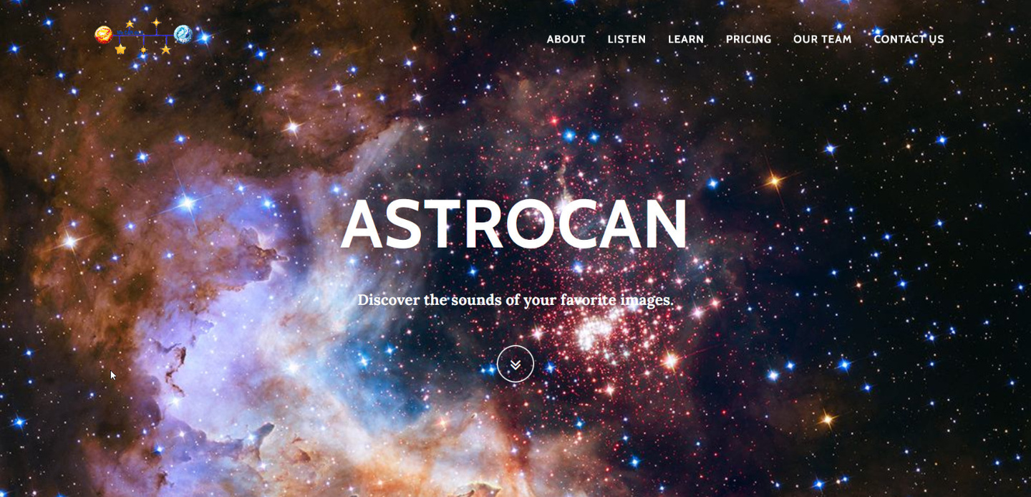
The solution
A meditation app that generates music based on the uploaded image, that focuses both on the mental wellbeing of the user and its thirst of knowledge.

Slide 4

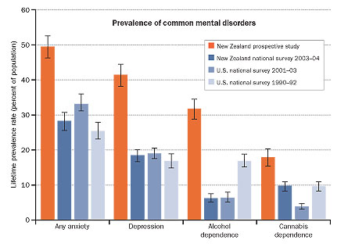
Our motivation
Major depression is a common and potentially lethal condition.
Early data suggest that the population-level burden of depression has been exacerbated by the COVID-19 pandemic.

Slide 5
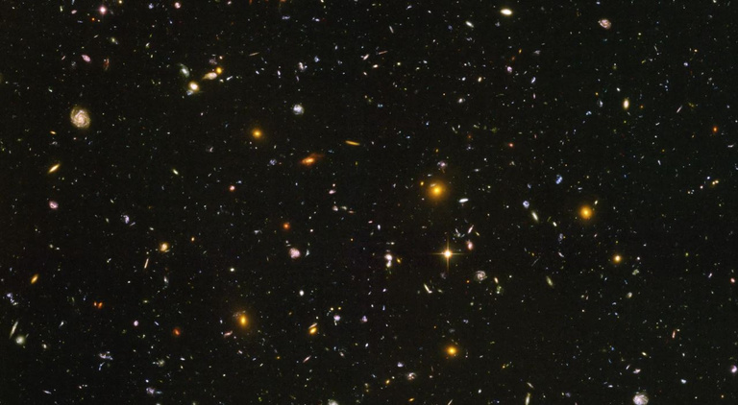
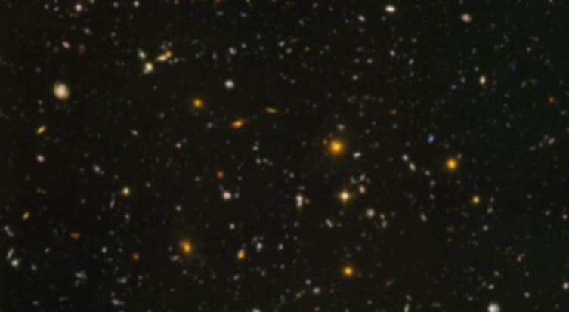
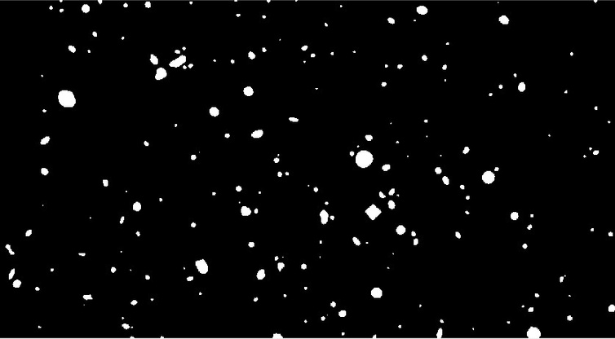
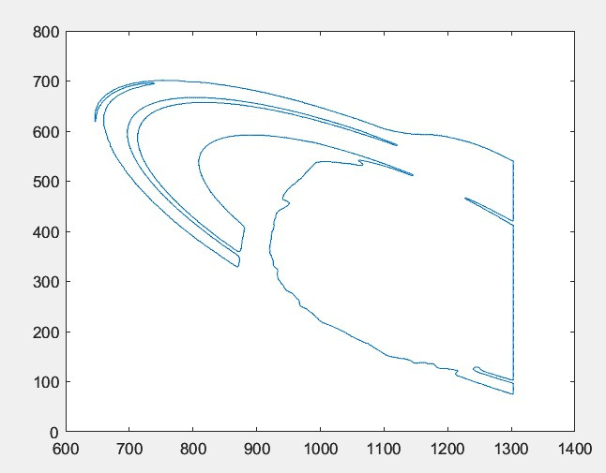
Implementation
Complex mathematical formulas
We used MATLAB and Python for image processing and sound generating.
Easy-to-use UI
We used HTML, CSS, React and Bootstrap in order to create a relaxing user experience.

Slide 6

Sustainability
1
Simple UI, doesn't require a lot of energy to run
It enhances brain function, productivity etc. through meditation induced by calming sounds and visual stimulation
2
3
Servers that host data run on solar energy, as opposed to the starry night theme of the app
Raising awareness through educational videoclips
4
Offline premium content
5
6
Package-based content, profits come from Pro subscription service

Slide 7
Thank you for your attention.
Feel free to ask us any questions.

